Slide 2

About KnowBe4
KnowBe4 is the world's most popular integrated platform for awareness training combined with simulated phishing attacks.
We help thousands of organizations manage the problem of social engineering
Partnership with ‘The World’s Most Famous Hacker’ Kevin Mitnick

Slide 3
Why KnowBe4 Security Awareness Program?
“The training should be provided to all employees including senior management and the board.”
  “A formalized plan should be put in place to provide ongoing technical training to cybersecurity specialists within the institution.”
“Cybersecurity awareness and information should be provided to the institution’s customers, clients, suppliers, partners, outsourced service providers and other third parties who have links to the bank’s IT infrastructure.” - Central Bank of Kenya
  “Oversee the management of IT, including overseeing that:
  IT risks are integrated into organisation-wide risk management,
“The organisation responds to disruptive technologies,
consider receiving periodic independent assurances on the organisation’s IT arrangements, including outsourced services,
disclose the governance and management of IT by the organisation, including disclosing an overview, focus areas, actions taken and plans.” –South Africa Institute of Chartered Accountants

Slide 4

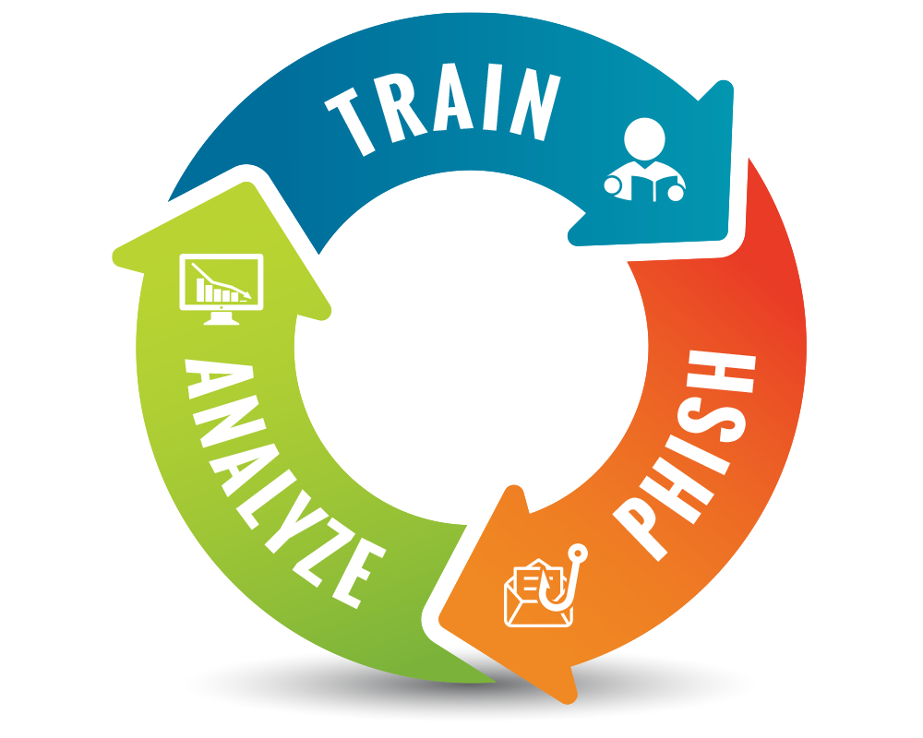



The KnowBe4 Security Awareness Program WORKS
Baseline Testing
We provide baseline testing to assess the Phish-prone™ percentage of your users through a free simulated phishing attack.
Train Your Users
On-demand, interactive, engaging training with common traps, live Kevin Mitnick demos and new scenario-based Danger Zone exercises and educate with ongoing security hints and tips emails.
Phish Your Users
Fully automated simulated phishing attacks, hundreds of templates with unlimited usage, and community phishing templates.
See the Results
Enterprise-strength reporting, showing stats and graphs for both training and phishing, ready for management. Show the great ROI!

Slide 5
KnowBe4 vs Wombat vs PhishMe as per Gartner Q2 2017
Product Capabilities
 | KnowBe4 340 Reviews | Wombat 50 Reviews | PhishMe 181 Reviews
Overall rating of product capabilities | 4,8 | 4,5 | 4,8
Vendor's phishing simulation capabilities | 4,9 | 4,8 | 4,4
The production quality of the vendor's training modules | 4,6 | 4,7 | 4,4
The content quality of the vendor's training modules | 4,7 | 4,8 | 4,5
The availability of content to cover the topics that your company needed | 4,7 | 4,5 | 4,6
Quality and availability of administrator training | 4,7 | 4,3 | 4,3
The quality of the vendor's Learning Management System | 4,7 | 4,4 | 4,5
The quality of the vendor's administrative interface and reporting capabilities | 4,6 | 4 | 4,2

Slide 6
KnowBe4 vs Wombat vs PhishMe as per Gartner Q2 2017
Customer experience
 | KnowBe4 334 Reviews | Wombat 47 Reviews | PhishMe 151 Reviews
Evaluation & Contracting | 4,8 | 4,6 | 4,6
Pricing Flexibility | 4,7 | 4,5 | 4,5
Integration & Deployment | 4,8 | 4,5 | 4,6
Ease of Deployment | 4,8 | 4,7 | 4,6
Timeliness of Vendor Response | 4,9 | 4,7 | 4,8
Quality of Technical Support | 4,8 | 4,6 | 4,7

Slide 7
KnowBe4 vs Wombat vs PhishMe as per Gartner Q2 2017
96% voted yes for KnowBe4
340 Reviews as per Gartner 2017 Q2 results

Slide 8
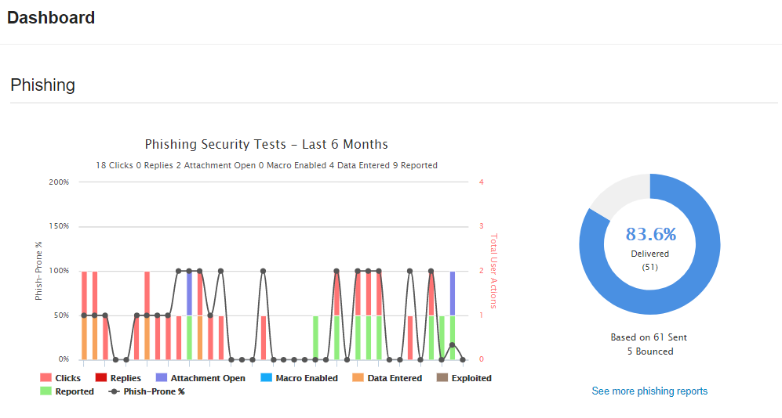
Enhanced Reporting

Slide 9
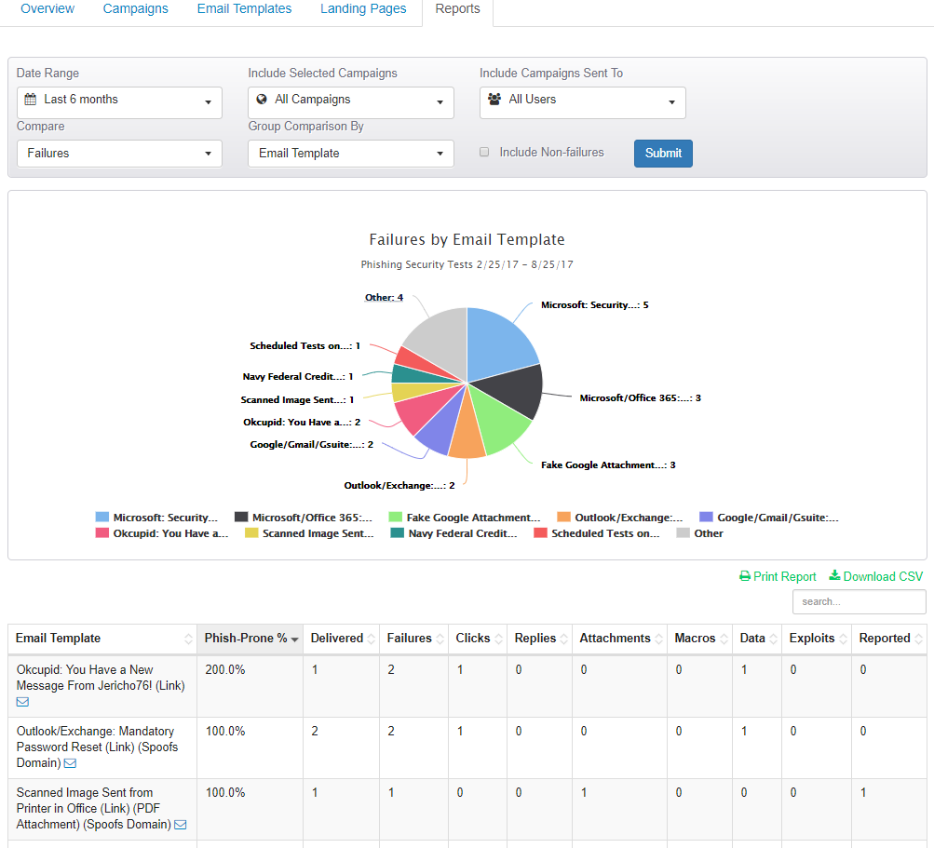
Enhanced Reporting

Slide 10
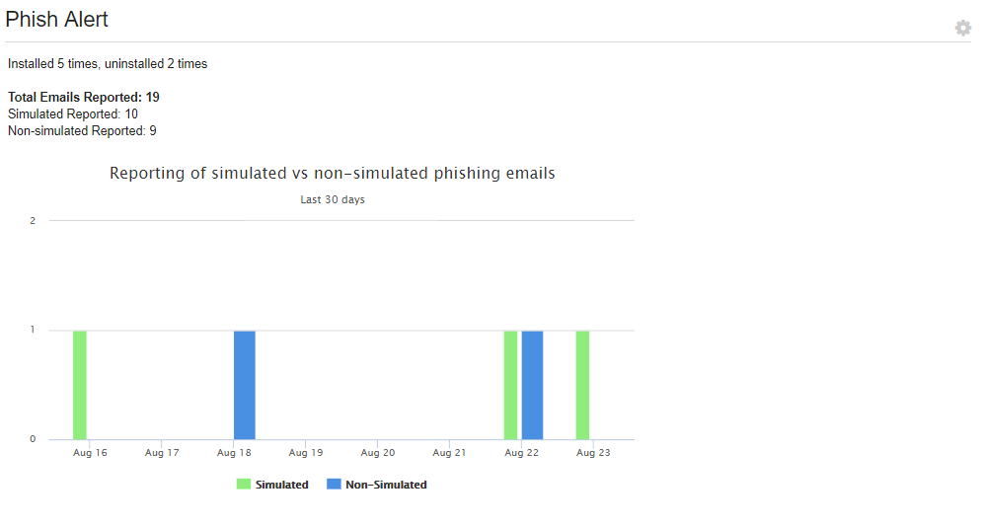
Realtime Responsiveness

Slide 11
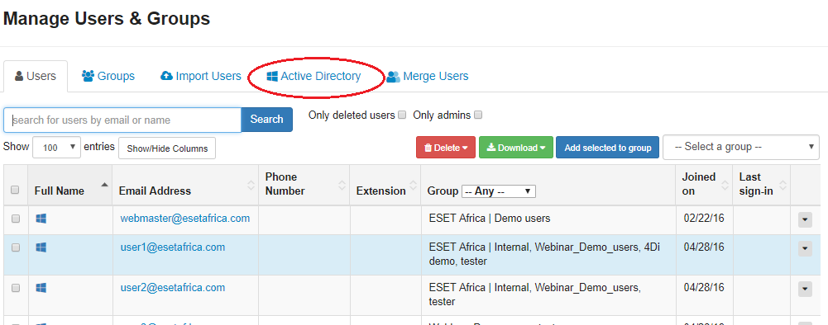
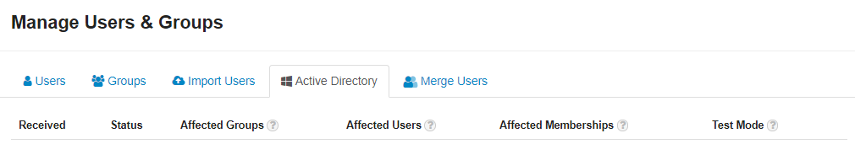
Easy Active Directory Integration

Slide 12
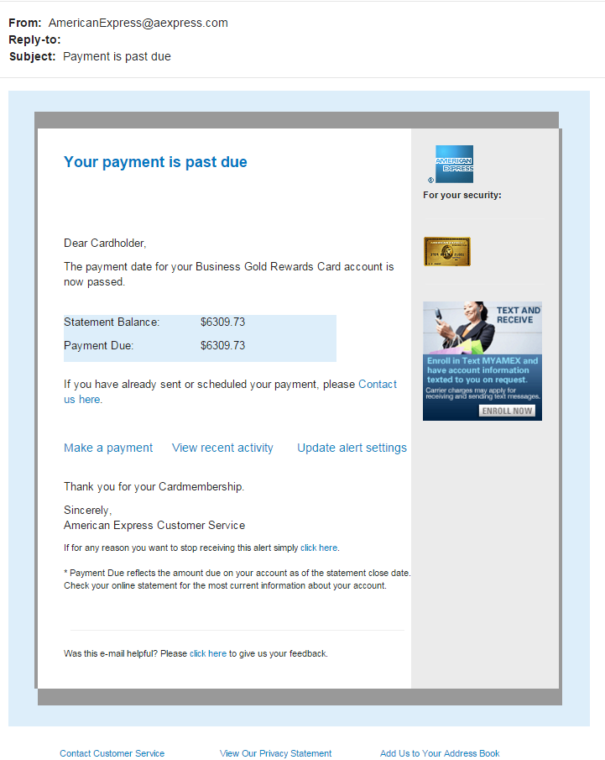
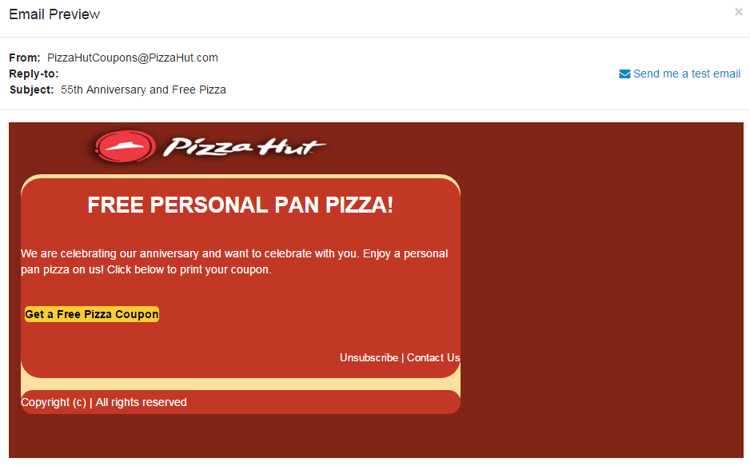
Targeted, Customizable templates

Slide 13
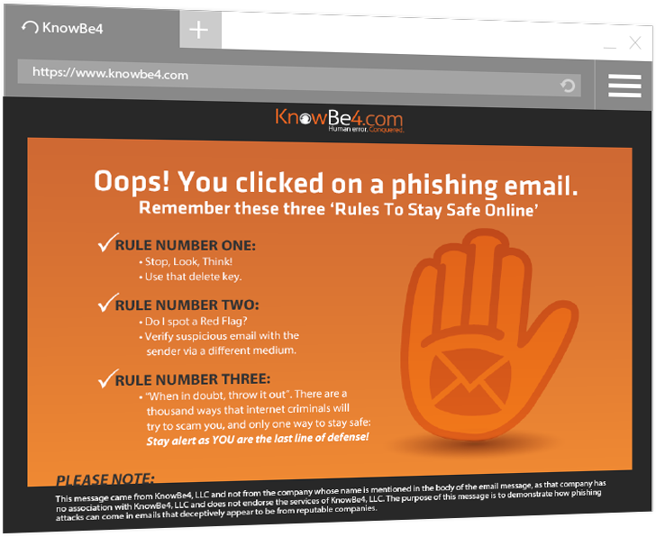
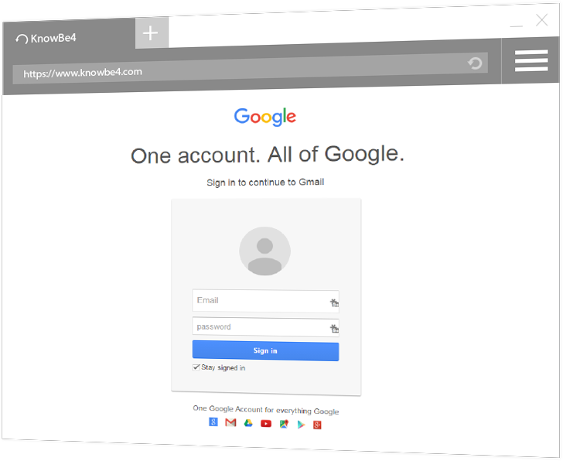
Targeted, Safe and Customizable landing pages

Slide 14
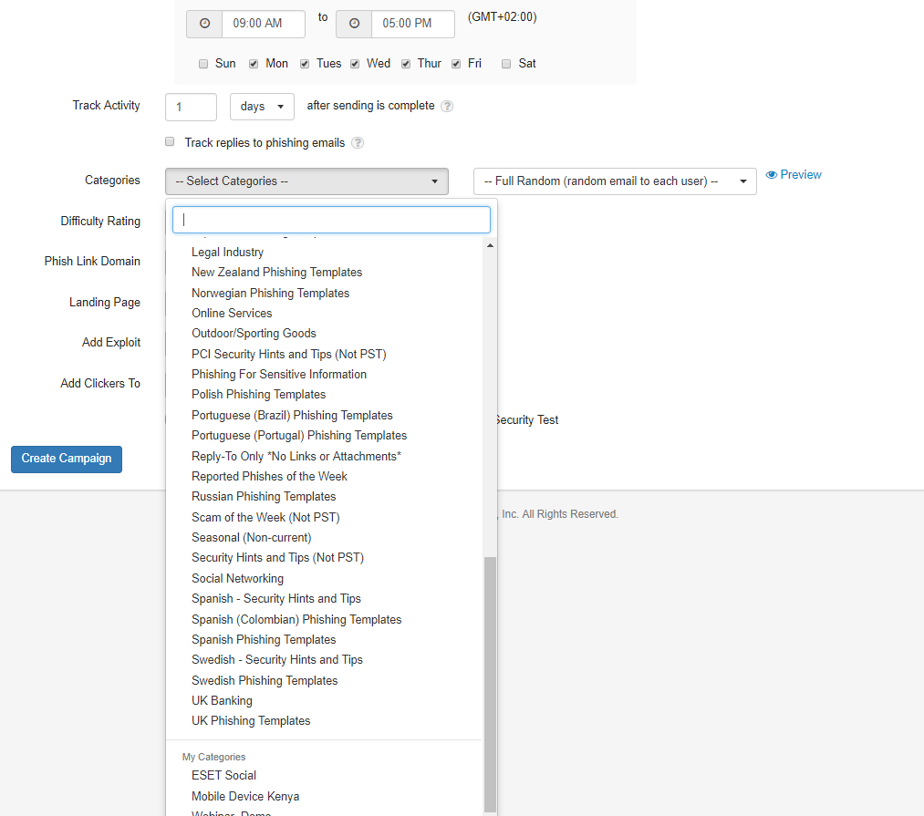
Growing and Updated number of categories and templates

Slide 15
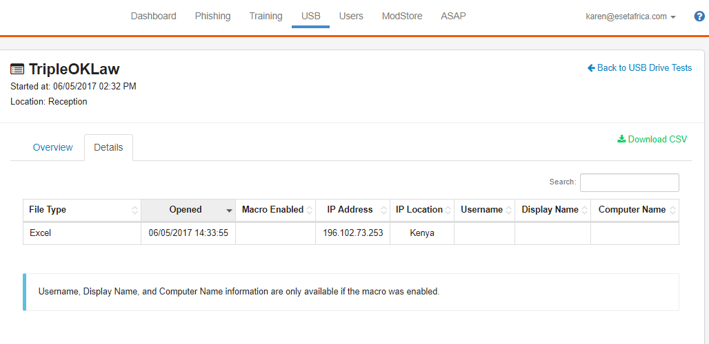
USB Drive Test

Slide 16
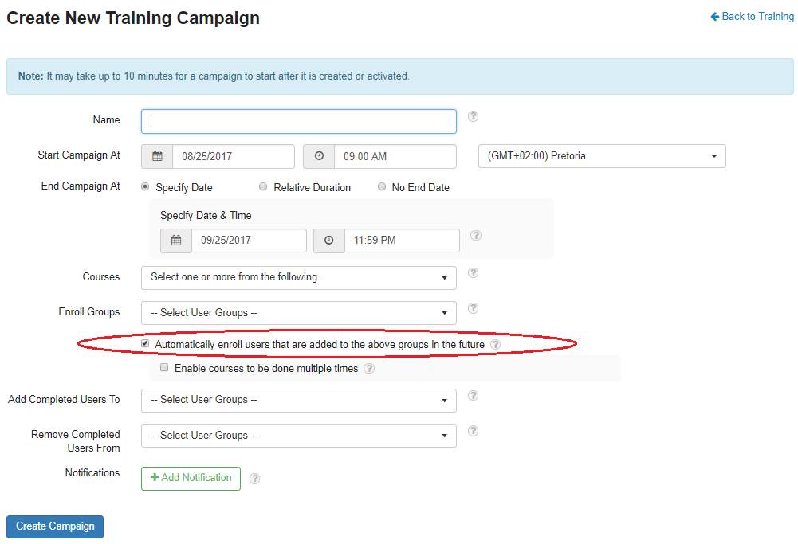
“Admin-lite” and scalable training roll-outs

Slide 17
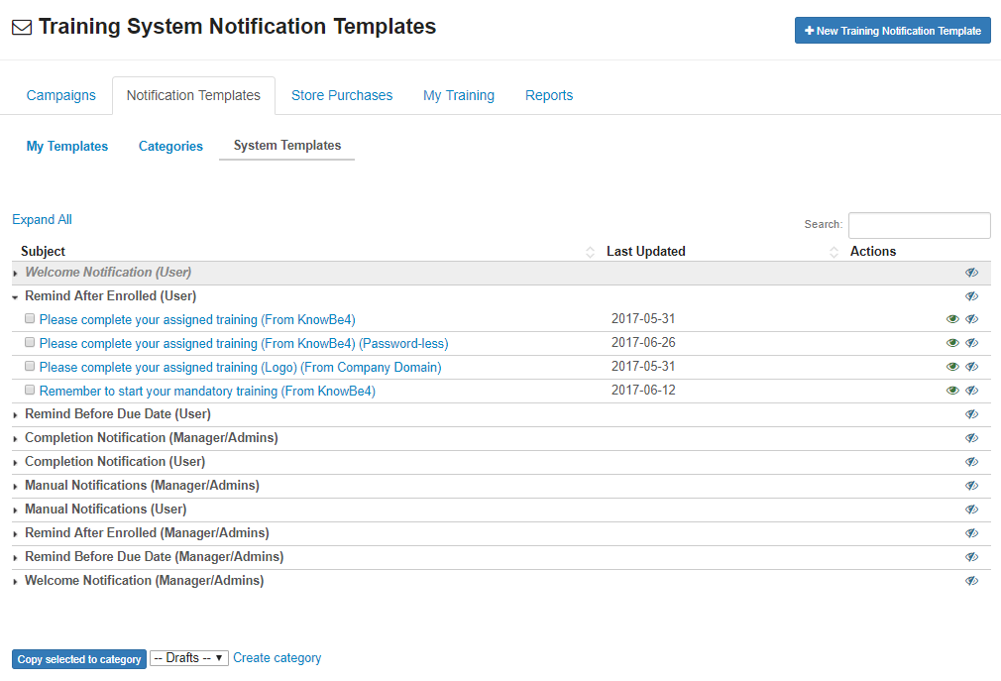
Customizable Notification templates

Slide 18
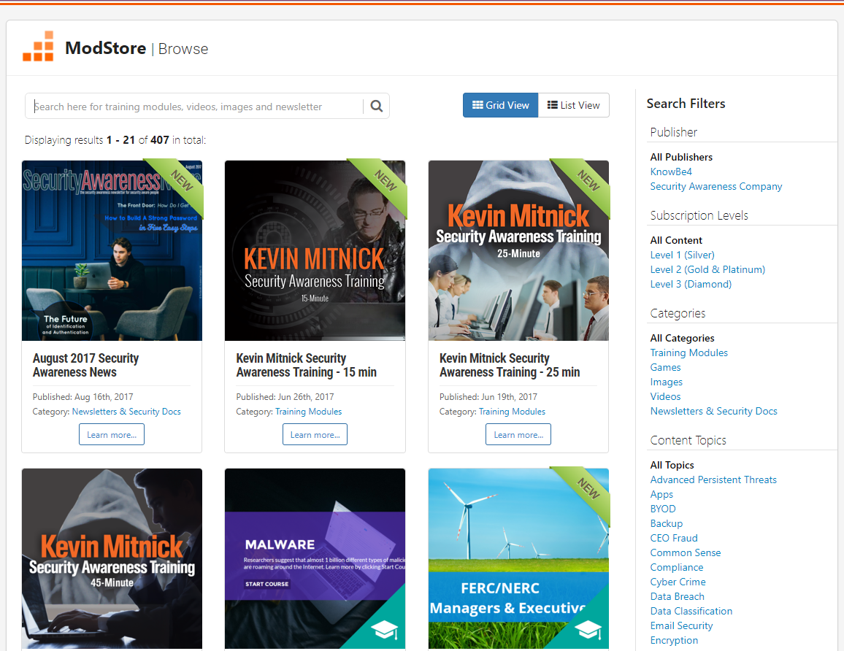
Targeted training

Slide 19
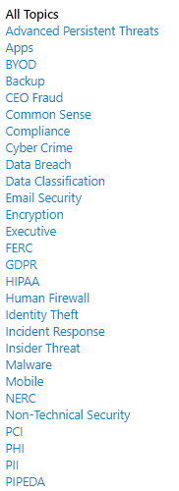
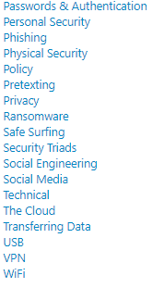
Targeted training

Slide 20
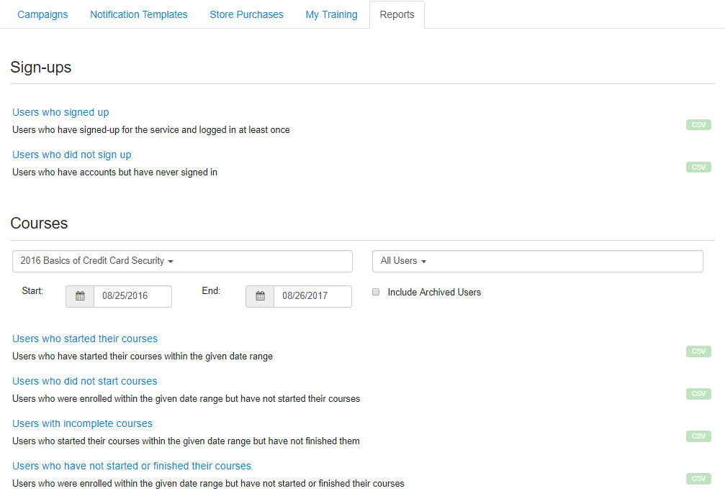
Enhanced Reporting

Slide 21
Thank you

